Slide 1
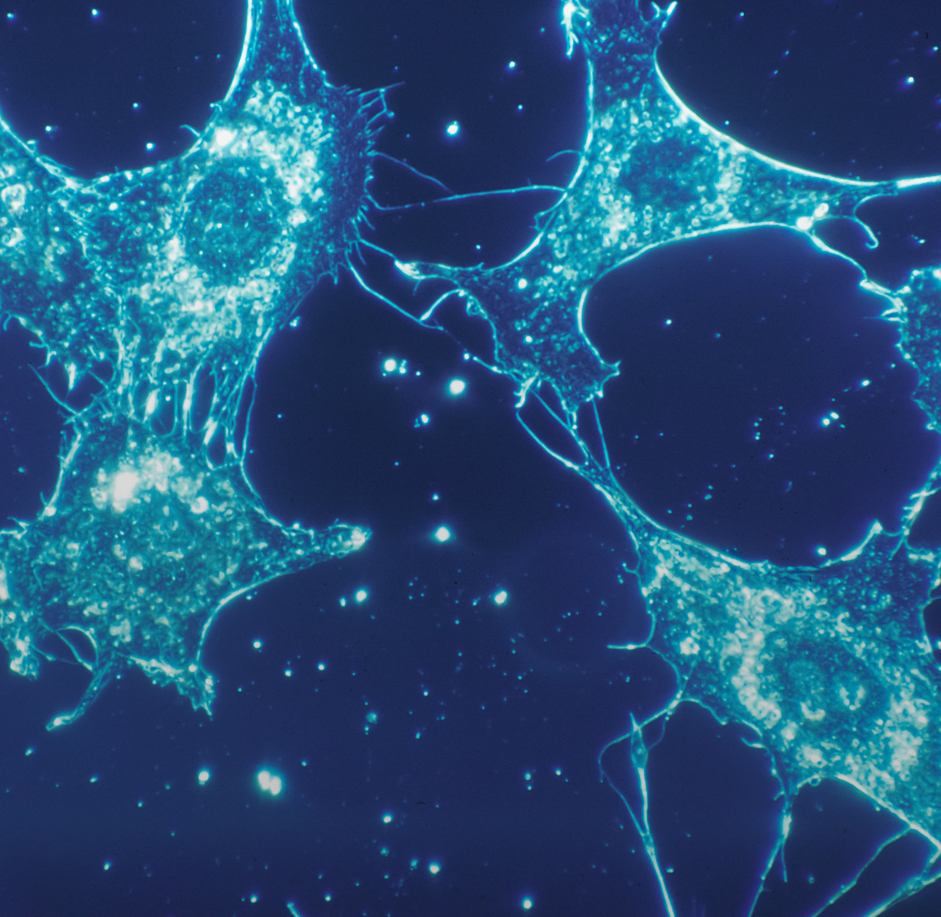
Breast Cancer Prediction Model Development Report
Springboard Data Science Track Capstone Two
Presented by Fiona Pang

Slide 2
Agenda
Introduction
Data Exploration
Modeling
Summary and Conclusion

Slide 3
Introduction
Cell nuclei characteristics from Fine Needle Aspirate images (FNA) is used to diagnose cancer.
A numerical dataset of breast cancer cell provided by the University of Wisconsin, Clinical Sciences Center,
Aiming to develop a machine learning model to classify and predict if the tumor is benign or malignant and the possibility of breast cancer

Slide 4
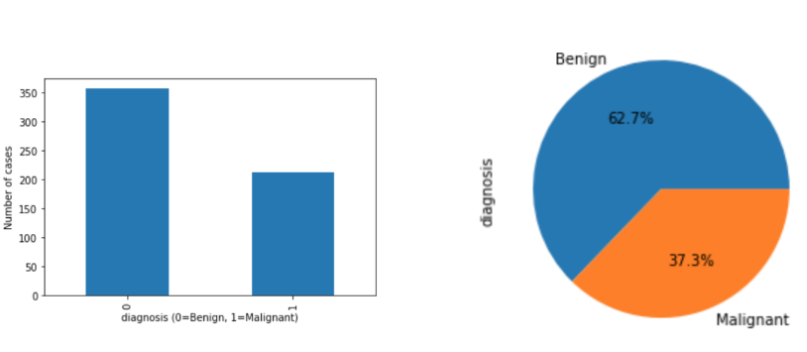
Data Exploration
Total 569 cases
212 Malignant (62.7%)
357 Benign (37.3%)

Slide 5
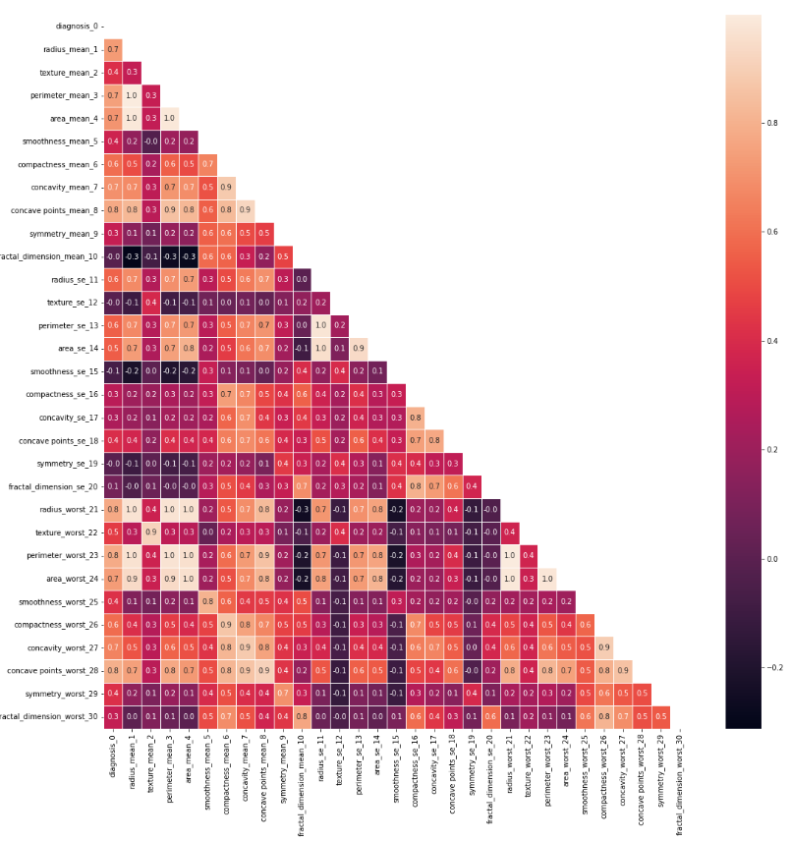
Data Exploration
Some features are strongly correlated to digagnosis result,
such as "texture_mean", "fractal_dimension_mean", "texture_se", "smoothness_se", "symmetry_se"...etc.

Slide 6
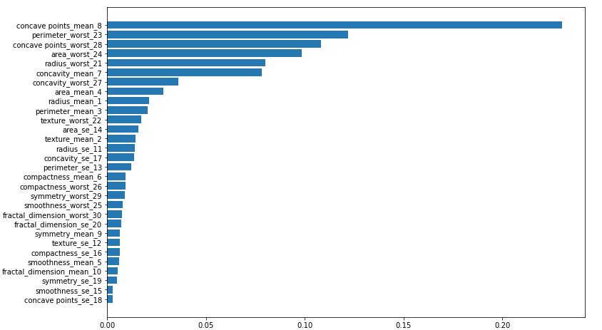
Data Exploration
* Feature importance and feature selection

Slide 7
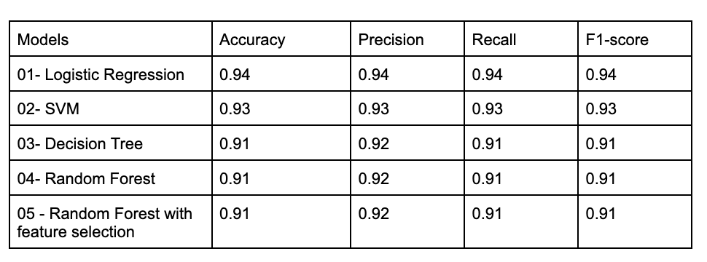
Modeling

Slide 8
Summary & Conclusion
The purpose of the project aims to develop a machine learning model to classify the breast tumor as benign or malignant based on numeric features from FNA images.
Five different machine models were tuned and tested on the processed dataset.
The model logistic regression, which has an accuracy of 94%, is the best fit model to predict and classify tumors as malignant or benign.
The model is limited by the amount of data present in the dataset, which only consist of 569 cases.
A larger collection of data may be needed to validate the model further.

